Slide 1
7
Free electrons
7.1 Plasma reflectivity
7.2 Free carrier conductivity
7.3 Metals
7.4 Doped semiconductor
7.5 Plasmons

Slide 2
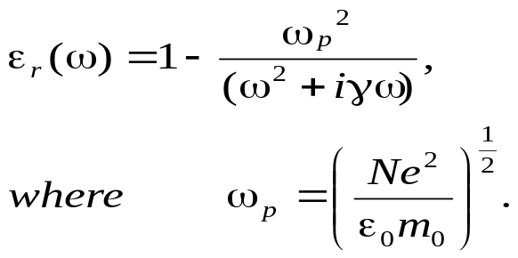
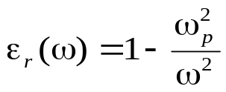
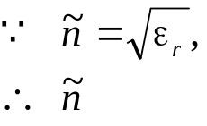
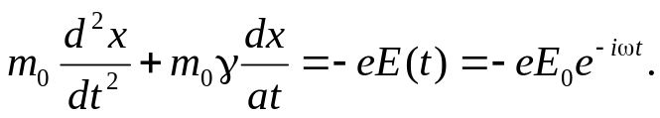

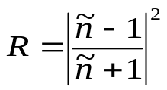
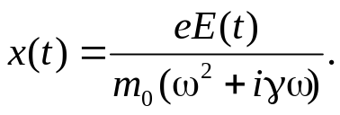
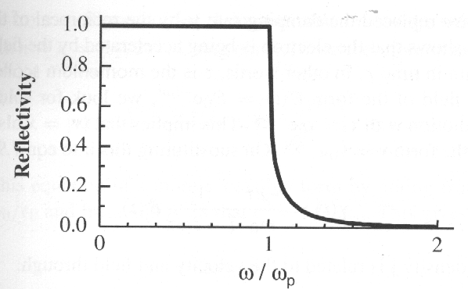
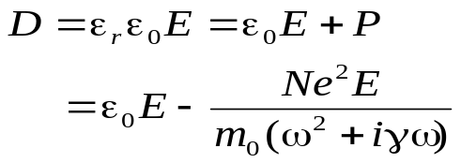
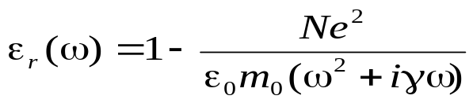
Plasma: A neutral gas of heavy ions and light electrons. Metals and doped semiconductors can be treated as plasmas because they contain equal numbers of fixed positive ions and free electrons. Free electrons in this system experience no : restoring force from the medium when they interact with electromagnetic waves. driven by the electric field of a light wave.
ω_{p}: plasma frequency
For a lightly damped system, γ = 0, so that
7.1 Plasma reflectivity
Drude-Lorentz model:
Considering the oscillations of a free electron induced by AC electric field E(t) of a light wave with polarized along the x direction:
is imaginary for ω < ω_{p},
positive for for ω > ω_{p}
zero for ω = ω_{p},
The reflectivity:
By substituting
The electric displacement:
Therefore:
Reflectivity of an undamped free carrier gas as a function of frequency.

Slide 3

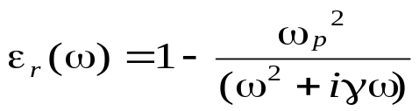
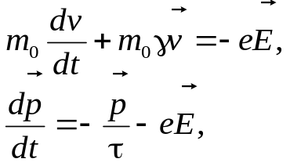
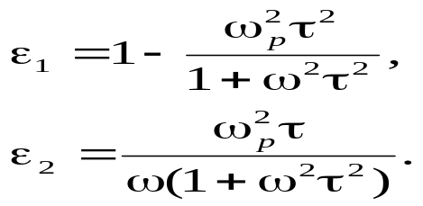
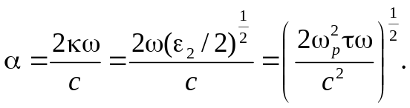
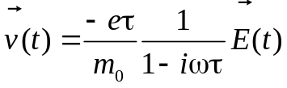
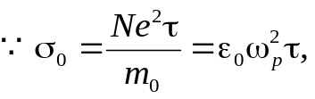


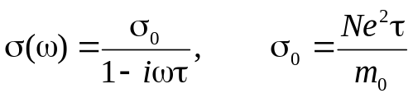
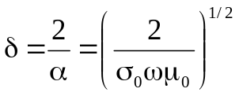
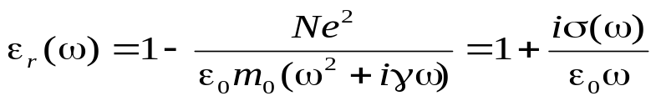
7.2 Free carrier conductivity
Thus optical measurements of ε_{r}(ω) are equivalent to AC conductivity measurement of σ(ω).
Considering the damping and the electron velocity
By splitting
, the momentum p = m₀v
into its real and imaginary components:
这个方程的解本身就很像e指数衰减，所以有个寿命在
The damping time τ = 1/γ. The shows that the electron is being accelerated by the field, but loses its momentum in the time τ. So τ is the momentum scattering time. τ is typically in the range 10⁻¹⁴—10⁻¹³s, hence optical frequency must be used to obtain information about τ.
By substituting v = v₀e^{-iωt},
n, κ and α, the real and imaginary parts of the complex refractive index and the attenuation coefficient can be worked out. At very low frequencies that satisfy ωτ << 1 and ε₂ >>ε_{1,}, n ≅ κ = (ε₂ / 2 )^{1/2}, thus:
它也可以由上一页的x解dx/dt得到
The current density:
This gives:
where the AC conductivity σ(ω):
对比得
The attenuation coefficient is proportional to the square root of the DC conductivity and the frequency.
Define the skin depth δ:
where σ₀ is the DC conductivity.
This implies that AC field can only penetrate a short distance into a conductor such as a metal.

Slide 4
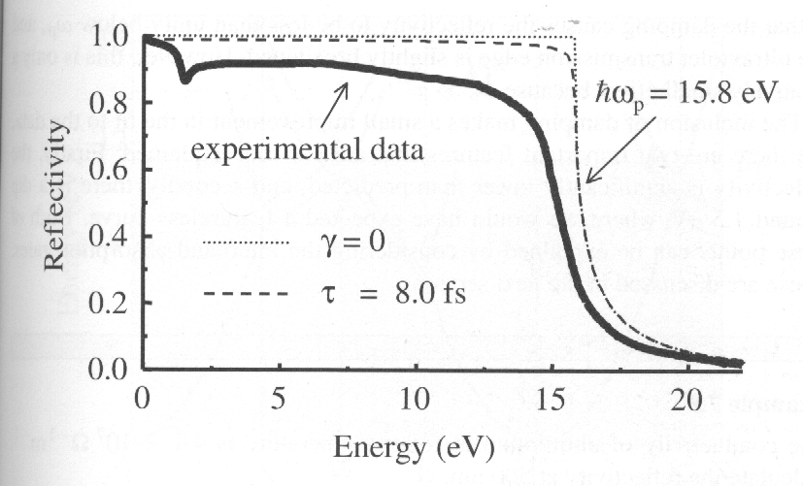
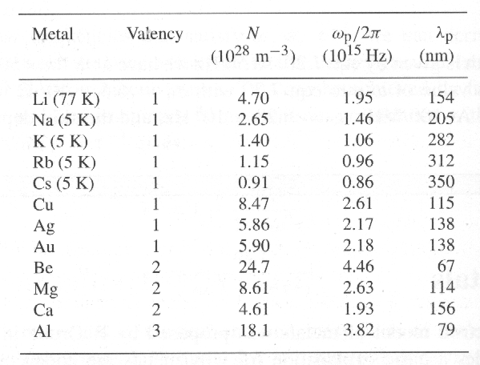
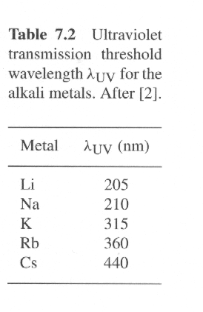
7.3 Metals
7.3.1 The Drude model
The valence electrons is free. The density N is equal to the density of metal atoms multiplied by their valency;
The characteristic scattering time τ can be determined by the measurement of σ.
Experimental reflectivity of Al as a function of photon energy. The experimental data is compared to predictions of the free electron model with hω = 15.8 eV. The dotted line is calculated with no damping. The dashed line with τ = 8.0×10⁻¹⁵ s, which is the value deduced from the DC conductivity.
All metals will become transmitting if ω > ω_{p} ( UV transparency of metals)
Free electron density and plasma properties of some metals. The values of N are in the range 10²⁸—10²⁹ m⁻³. the very large values of N lead to plasma high electrical and thermal conductivities and plasma frequency in the UV region.
The figure shows that the reflectivity of Al is over 80% up to 15 eV, and then drops off to zero at higher frequencies.
From this figure, one can see that the model accounts for the general shape of the spectrum, but there are some important detials that are not explained.

Slide 5
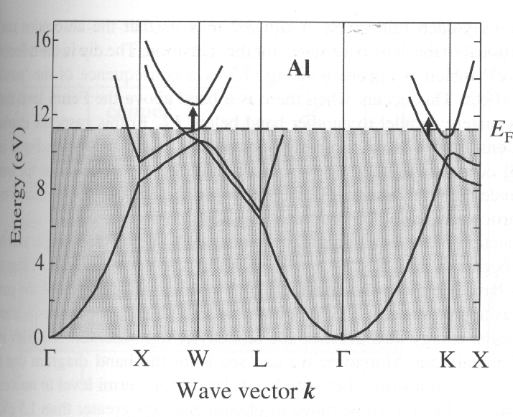
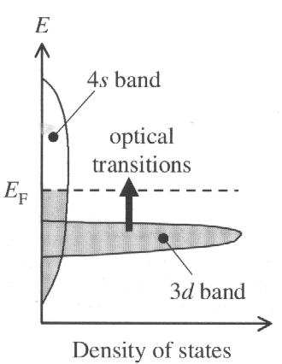
7.3.2 Interband transitions in metals
Electronic configuration: [Ne]3s²3p¹ with three valence
electrons; the first Brillouin zone is completely full, and the valence electrons spread into the second, third and slightly into the fourth zones. The bands are filled up to the Fermi energy E_{F}, and direct transitions can take place from any the states below the Fermi level to unoccupied bands directly above them on the E—k diagram. “parallel band effect” corresponding to the dip in the reflectivity at 1.5 eV originates the high density of states between the two parallel bands. Moreover, there are further transition at a whole range of photon energies greater than 1.5 eV. The density of states for these transition will be lower than at 1.5 eV because the bands are not parallel, however, the absorption rate is still significant, and accounts for the reduction of the reflectivity predicted by the Drude model..
Interband absorption is important in metals because the EM penetrate a short distance into the surface, and if there is a significant probability for interband absorption, the reflectivity will be reduced from the free carrier value. The interband absorption spectra of metals are determined by their complicated band structures and Fermi surfaces. Furthermore, one needs to consider transitions at frequencies in which the free carrier properties are also important.
Aluminium
Copper
[Ar]3d¹⁰4s¹,
The wide outer 4s band (1),
Approximately free electron states
Dispersion : E = h² k²/2m_{0;}
The narrow 3d band (10)
More tightly bound
Relatively dispersionless
The Fermi energy lies in the middle of the 4s band above the 3d band
A well-defined threshold for interband transitions from the 3d to the 4s.
Band diagram of Al at the W and K points that are responsible for the reflectivity dip at 1.5 eV are labelled

Slide 6
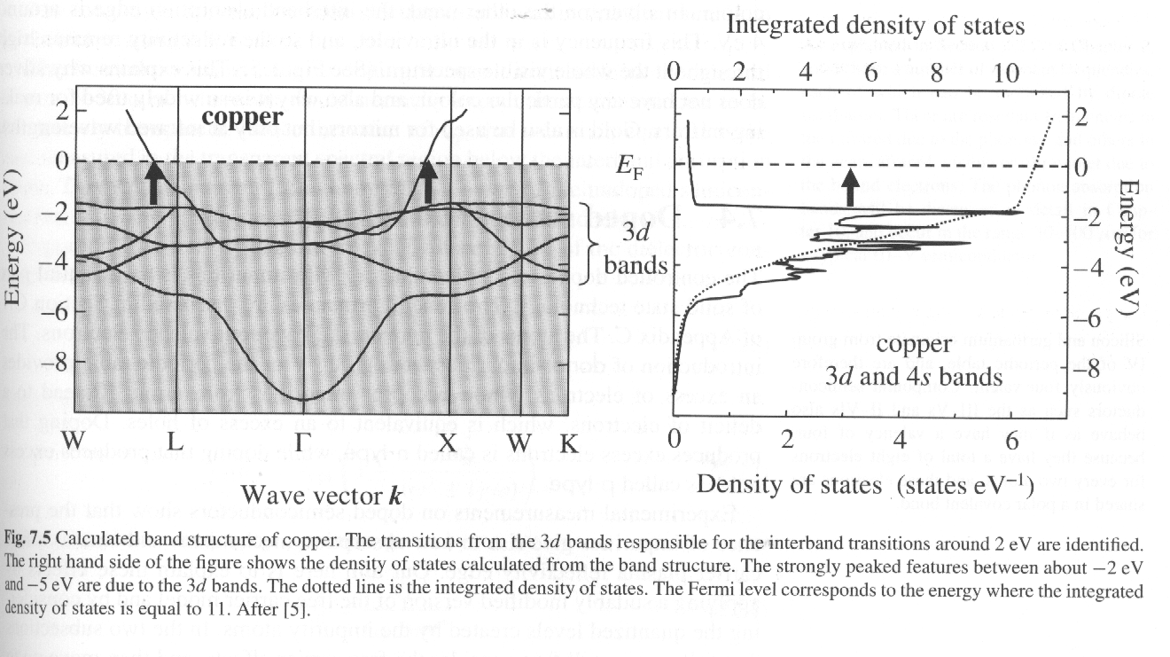
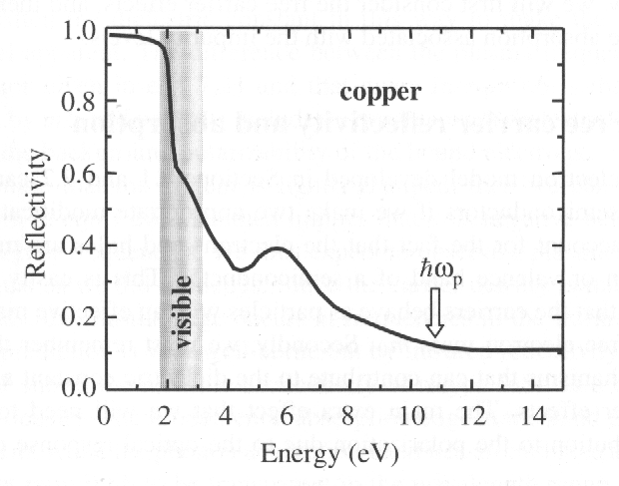
7.3.2 Interband transitions in metals
Copper
Gold and silver
In gold the interband absorption threshold occurs at a slightly higher energy than copper.
In silver the interband absorption edge is around 4 e, the frequency is in the ultraviolet, and so the reflectivity remains high throughout the whole visible spectrum.
The 3d electrons lie in relatively bands with very high densities of states, while the 4s are much broader with a low density of states. The Fermi energy lies in the middle of the 4s band above the 3d band. Interband transition are possible from the 3d band below E_{F}. The lowest energy transitions are marked on the band diagram. The transition energy is 2.2 eV which corresponds to a wavelength of 560 nm.
The measured reflectivity of copper. Based on the plasma frequency, one would expect near-100% reflectivity for photon energies below 10.8 eV (115nm). However, the experimental reflectivity falls off sharply above 2 eV due to the interband absorption edge. The explain why copper has a reddish colour.

Slide 7
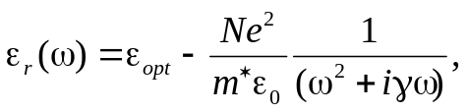
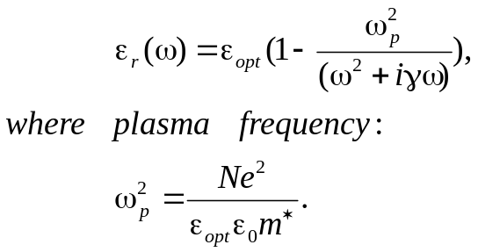
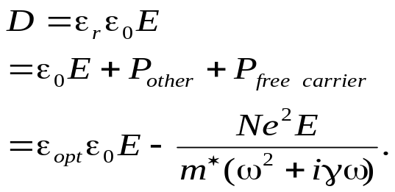
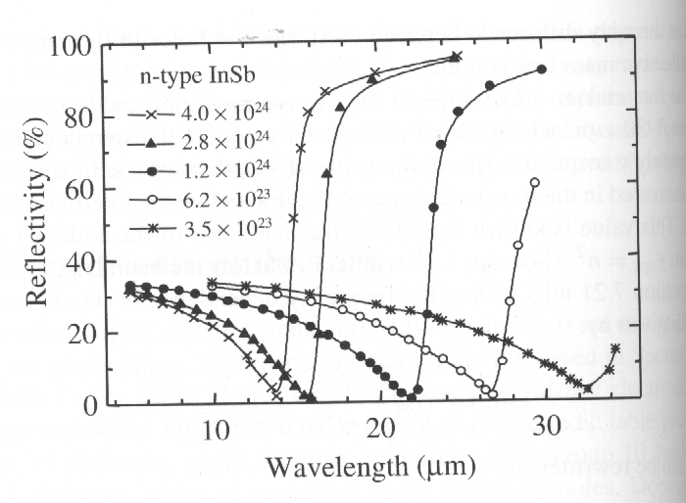
7.4 Doped semiconductors
n-type: donor impurities have five valence electrons;
P-type: acceptor impurities have three valence electrons.
The presence of impurities give rise to new absorption mechanisms and also to a free carrier plasma reflectivity edge.
7.4.1 Free carrier reflectivity and absorption
Two modifications:
Replace the free electron mass m₀ by an effective
mass m* (the electrons and holes move in the bands);
other mechanisms, e.g. the optical response of the
bound electrons, contribute to the dielectric constant
as well as the free carrier effects.
The electric displacement in the doped semiconductors:
Replace m₀ by m*;
Account for the background polarizability of the
bound electrons.
If γ→0
ε_{r} < 0 below ω_{p}
ε_{r} > 0 above ω_{p}
the plasma edge occurs at frequencies in the infrared range (N is much more smaller than in metals).
Free carrier absorption
Where N is the density of free electrons or holes generated by the doping process. The only difference betweens electron and holes in the formula is in the effective mass m*.
The free carrier effects → 5 – 30 μm
ε_{opt} is the dielectric constant in the spectrum region below the interband absorption edge. The value is known from the refractive index of the undoped semiconductor: ε_{opt} = n².
Free carrier reflectivity of n-type InSb at RT as a function of the free carrier density.

Slide 8
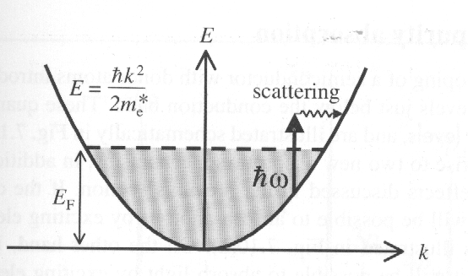
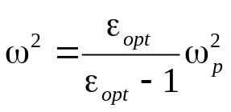
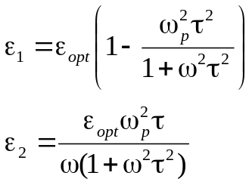
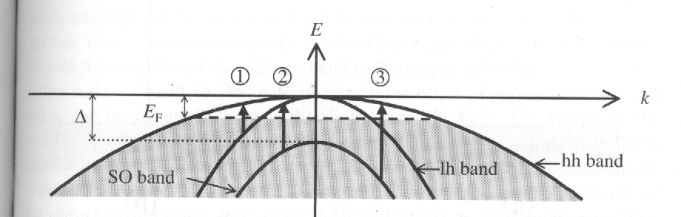
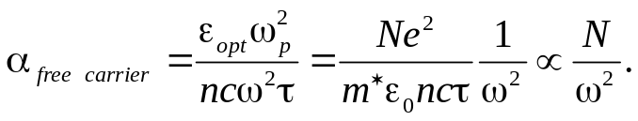

7.4.1 Free carrier reflectivity and absorption
processes with a single frequency-independent scattering time τ deduced from the DC conductivity.
Assume the system is lightly damped, γ → 0, κ →0, ε_{r} → 1, zero reflectivity occurs at a frequency given by:
By fitting this formula to the data, the effective mass of InSb can be determined.
By splitting the ε_{r} into its real and imaginary parts:
A free carrier transition in a doped semiconductor.
p-type semiconductors show another effect, this is called intervalence band absorption, in addition to those related with the free carriers.
In a typical semiconductor, with τ ~ 10⁻¹³ s at RT, ωτ >> 1 in near-infrared. Free carrier term in ε_{r} is small, therefore,
ε₁≅ ε_{opt} and ε₂ << ε₁ , n= (ε_{opt} )^{1/2} and κ = ε₂/ 2n. The absorption coefficient:
The figure shows the valence band of a p-type III-V semiconductor. The unfilled states near k=0 is due to the p-type doping. E_{F} is the Fermi energy determined by the doping density. The arrow indicate: (1) transition from the light hole (lh) band to the heavy hole (hh) band; (2) transition from the spilt-off (SO) band to the lh band; and (3) transitions from the SO band to the hh band. The absorption occurs in the infrared, and can be a strong process because no scattering events are required to conserve momentum.
Experimentally, β is in the range 2-3. The departure from the predicted value of 2 is caused by the failure of the assumption that τ is independent of ω. The mechanism that can contribute to the momentum conservation process include phonon scattering and scattering from their ionized impurities. It is oversimplification to characterize all the possible scattering

Slide 9
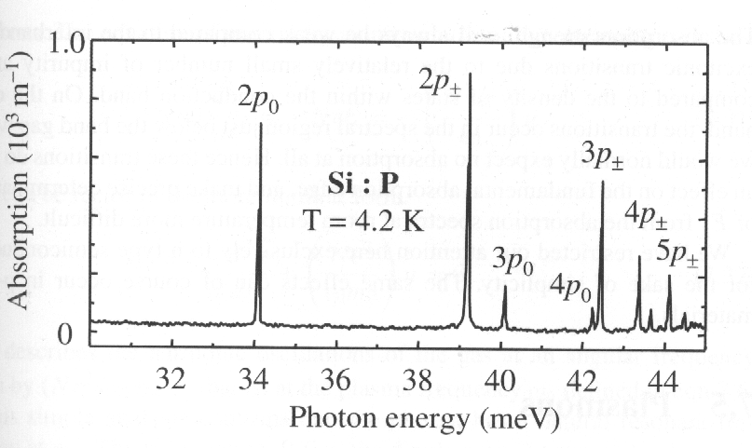
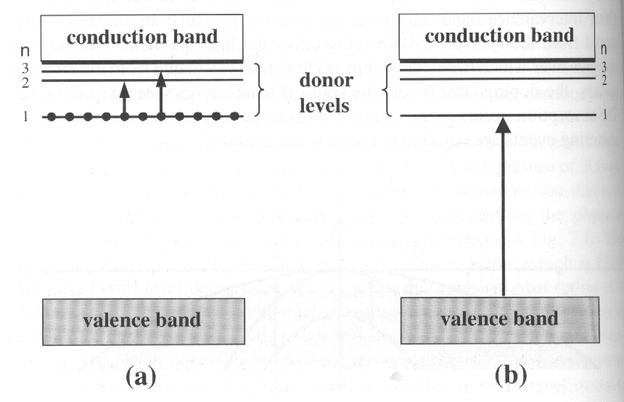
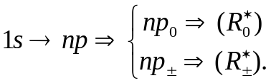
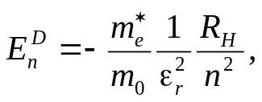
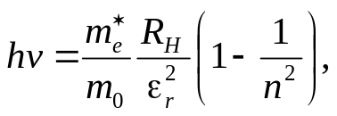
7.4.2 Impurity absorption
The n-type doping of a semiconductor with donor atoms introduces a series of hydrogentic levels – donor levels, just below the conduction band, which gives rise to two
Infrared absorption spectrum of n-tpye silicon doped with phosphorous at a density of 1.2 ×10²⁰ m⁻³. The frequency dependence of the two series can be modelled by assigning different effective Rydbergs for the “0” and “±” states.
new absorption mechanisms: (a) transitions between donor levels; (b) transitions from the valence band to empty donor levels. The energy of the donor levels:
The valence band → donor level transitions occur at temperature when the donor levels are partly unoccupied due to the thermal excitation of the electrons into the conduction band. The photon energies just below the band gap E_{g} with a threshold given by E_{g-}→ E₁^{D}. The absorption strength will always be weak compared to the interband and excitonic transitions due to the relatively small number of impurity atom.
Where R_{H} is the hydrogen Rydberg (13.6 eV). The transitions give rise to absorption lines analogous to the hydrogen Lyman series with frequencies give by:
The transitions occur in the infrared spectral region (0.01– 0.1eV).

Slide 10
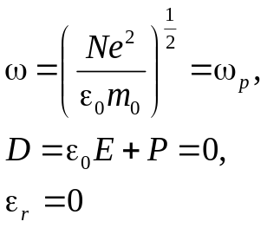
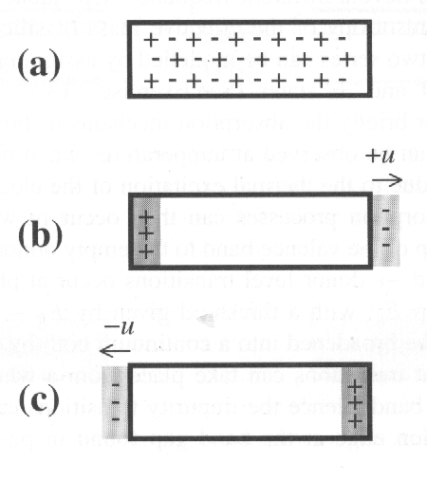


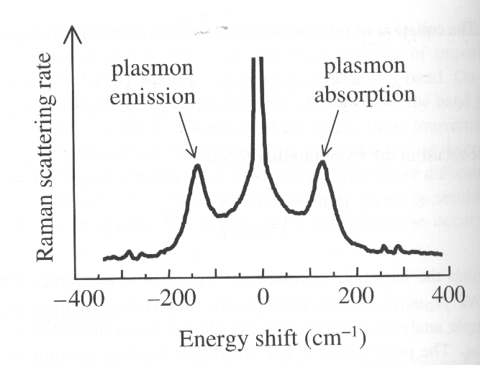
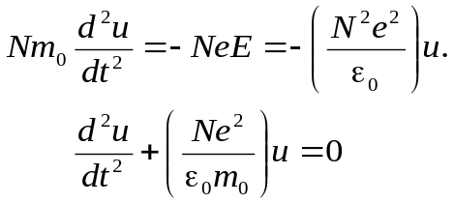
7.5 Plasmons
Plasmons: Quantized plasma oscillations
They can be observed by electron energy loss spectroscopy in metals, or Raman scattering in doped semiconductors
Electron energy loss spectroscopy:.
The reflected or transmitted electron will show an energy loss equal to integral multiples of the plasmon energy:
Raman scattering:
Photons are scattered through inelastic processes with the plasmons in the medium.
Longitudinal plasma oscillation in a slab from within the bulk of a metal. At equilibrium (a) the charges of the positive ions and electrons cancel and the metal is neutral. Displacements of the electron gas by ± u as a whole in either direction are shown in (b) and (c ). This give rise to the positive and negative surface charges (-Neu per unit area) shown by dark and light ahading respectively. The displacement lead to restoring forces that oppose the displacement and sustain oscillation at the plasma frequency.
The electric field E = Neu / ε₀ ,
The equation of motion for a unit volume of electron gas:
Raman scattering on n-type GaAs at 300 K. the doping density was 1.75×10²³ m⁻³, two peaks shifted by ± 130 cm⁻¹. The electron effective mass of GaAs is 0.067 m₀ and ε_{opt} is 10.6,
ω_{p}=2.8 ×10¹³ Hz (150 cm⁻¹)

Slide 11
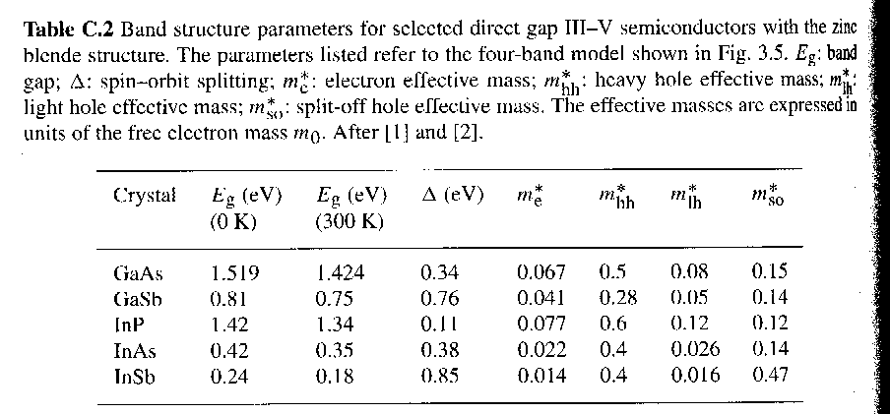
Exercises:
1. Zinc is a divalent metal with 6.6×10²⁸m⁻³ atoms per unit volume. Calculate its plasma frequency and account for
the shiny appearance of zinc.
2. The conductivity of aluminium at room temperature is 4.1×10⁻⁷ Ω⁻¹m⁻¹. Calculate the reflectivity at 500 nm(Table 1).
3. Consider the intervalence band processes illustrated in Fig.1 for a heavily doped p-yype sample of GaAs containing 1 ×10²⁵m⁻³ acceptors. The valence band parameters for GaAs are given in Table 2. (i) Work out the Fermi energy in the valence band on the assumption that the holes are degenerate. What are the wave vectors of the heavy and light holes at the Fermi energy? (ii) Calculate the upper and lower limits of the photon energies for the lh→hh absorption process. （涉及《半导体物理》，强p型掺杂，费米能级会深入到价带。）
Fig.1
Table 1

